Slide 1
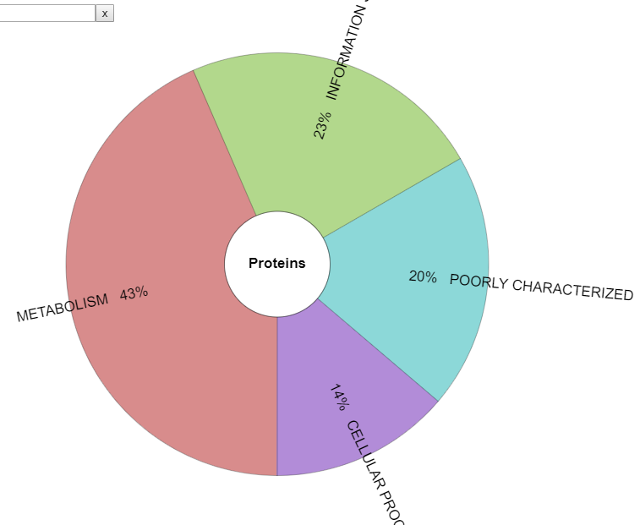
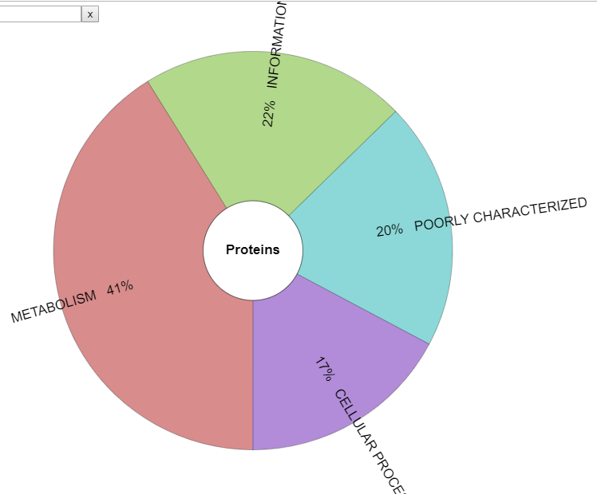
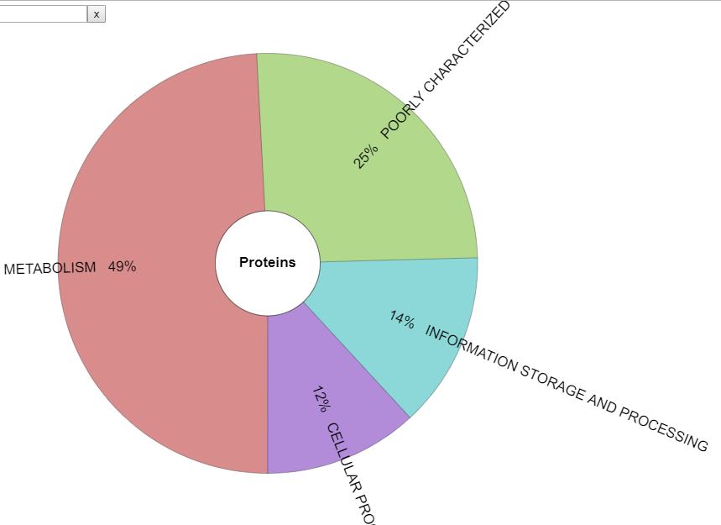
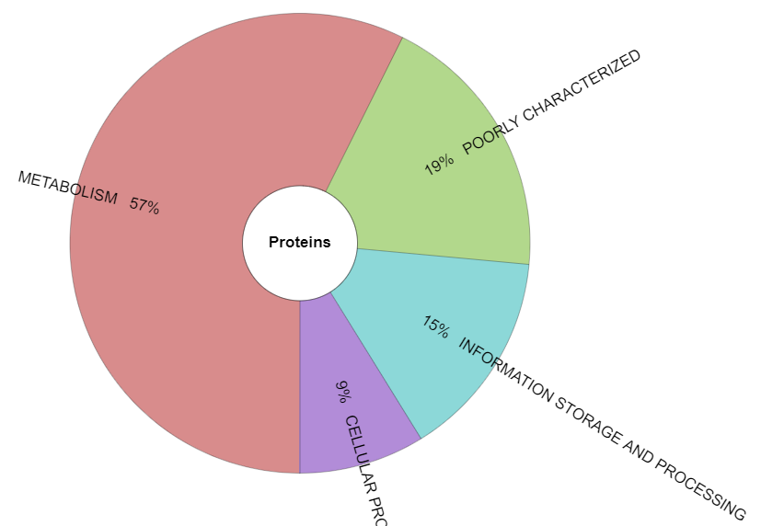
a) only detected in control
b) overexpressed in control
23 % INFORMATION STORAGE AND PROCESSING
22 % INFORMATION STORAGE AND PROCESSING
20 % POORLY CHARACTERIZED
20 % POORLY CHARACTERIZED
43 % METABOLISM
41 % METABOLISM
14 % CELLULAR PROCESSES AND SIGNALING
17 % CELLULAR PROCESSES AND SIGNALING
c) overexpressed in AC
d) only detected in AC
25 % POORLY CHARACTERIZED
19 % POORLY CHARACTERIZED
57 % METABOLISM
49 % METABOLISM
15 % INFORMATION STORAGE AND PROCESSING
14 % INFORMATION STORAGE AND PROCESSING
9 % CELLULAR PROCESSES AND SIGNALING
12 % CELLULAR PROCESSES AND SIGNALING

Slide 2
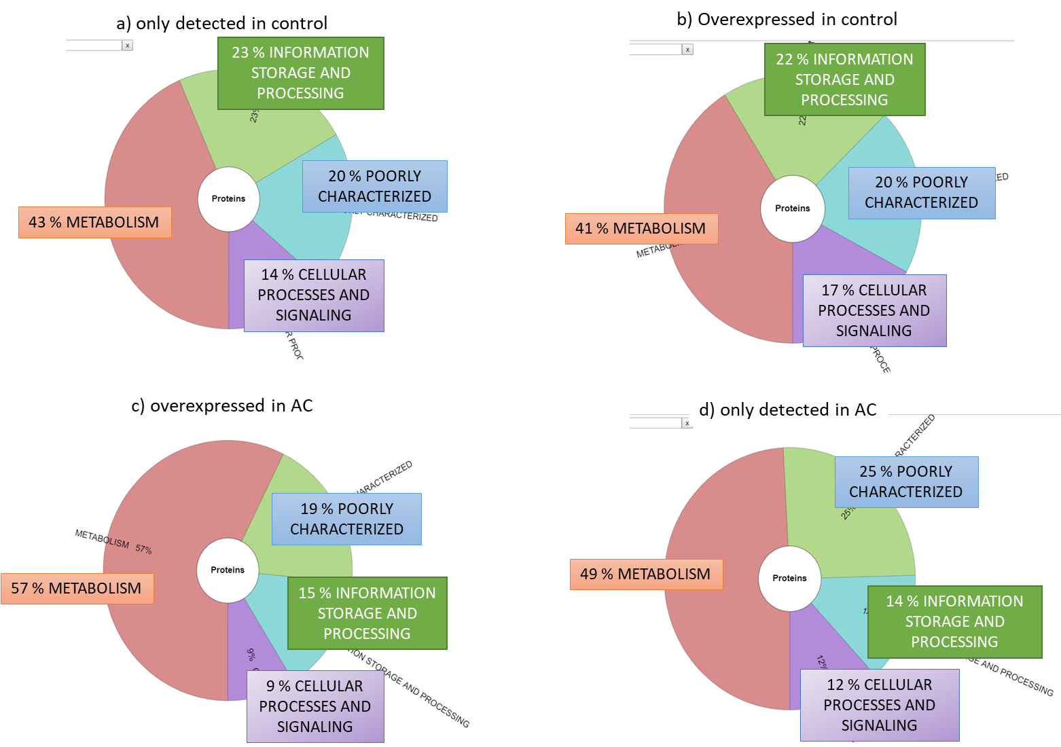

Slide 3
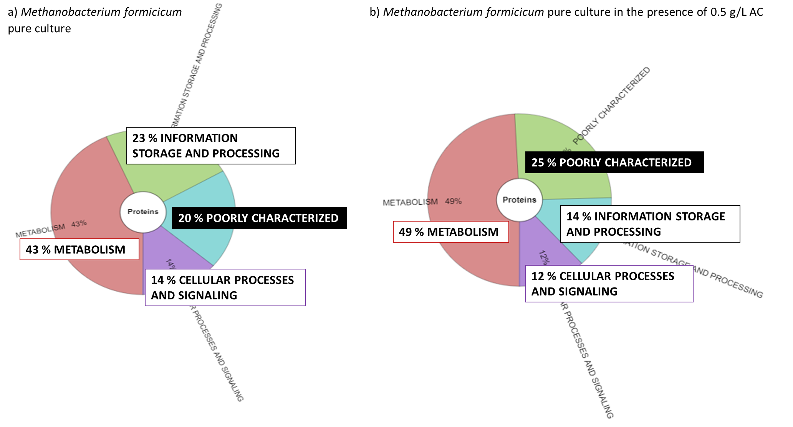

Slide 4
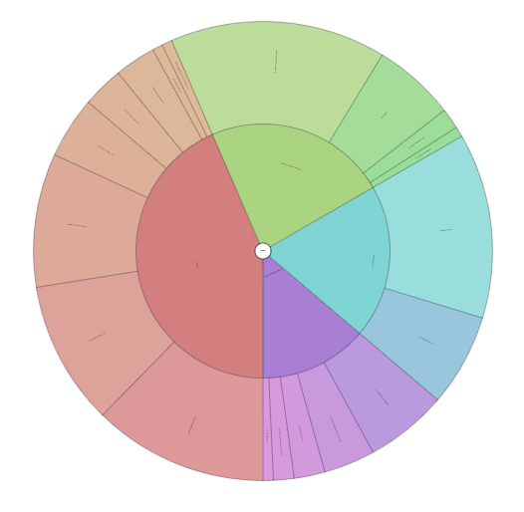
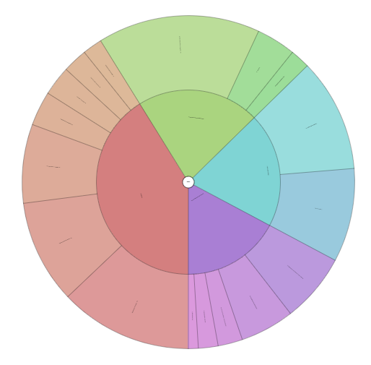
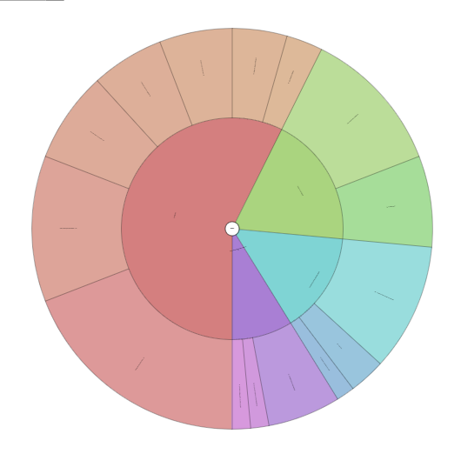
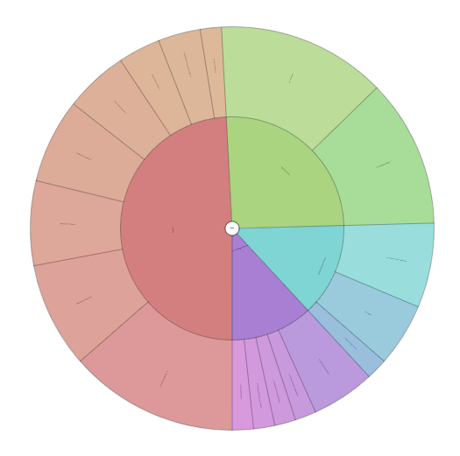
0.7 %
LTAM
0.7 %
SMBTAC
a) only detected in control
b) overexpressed in control
3 %
IITAM
COG functional category | Acronym
Amino acid transport and metabolism | AATAM
Energy production and conversion | EPAC
Coenzyme transport and metabolism | CTAM
Nucleotide transport and metabolism | NTAM
Carbohydrate transport and metabolism | CaTAM
Inorganic ion transport and metabolism | IITAM
Lipid transport and metabolism | LTAM
Secondary metabolites biosynthesis, transport and catabolism | SMBTAC
Translation, ribossomal structure and biogenesis | TRSAB
Transcription | T
Replication, recombination and repair | RRAR
Chromatin structure and dynamics | CSAD
Function unknown | FU
General function prediction only | GFPO
Cell wall/membrane/envelop biogenesis | CWMEB
Posttranslation modification, protein turnover, chaperones | PMPTC
Signal transduction mechanisms | STM
Intracellular traficking, secretion, and vesicular transport | ITSAVT
Defense mechanisms | DM
Cell cycle control, cell division, chromosome partitioning | CCCCDCP
15 %
TRSAB
1 %
RRAR
2 % CaTAM
16 %
TRSAB
3 % CaTAM
0.7 %
CSAD
2 % IITAM
4% T
2% RRAR
6% T
3 % LTAM
4 % NTAM
3 % NTAM
11 %
GFPO
9 %
CTAM
13 %
FU
8 %
CTAM
9 %
FU
10 %
EPAC
7 %
GFPO
10 %
AATAM
12 %
AATAM
7 % PMPTC
6 % CWMEB
13 %
EPAC
4 % PMPTC
5 % CWMEB
2 % STM
0.7 % DM
1 % ITSAVT
1 % DM
2% CCCCDCP
2% STM
c) overexpressed in AC
2% LTAM
d) only detected in AC
4%
IITAM
3% SMBTAC
6%
NTAM
3%
LTAM
3% CaTAM
6% CaTAM
5% IITAM
14% FU
12%
GFPO
7% CTAM
7%
NTAM
12%
GFPO
12%
AATAM
7%
FU
7%
EPAC
7% TRSAB
10%
TRSAB
8%
CTAM
5% T
19%
EPAC
3% T
14%
AATAM
2% RRAR
1% RRAR
5% CWMEB
1% ITSAVT
6% CWMEB
1% CCCCDCP
2% CCCCDCP
2% PMPTC
2% STM
2% ITSAVT

Slide 5
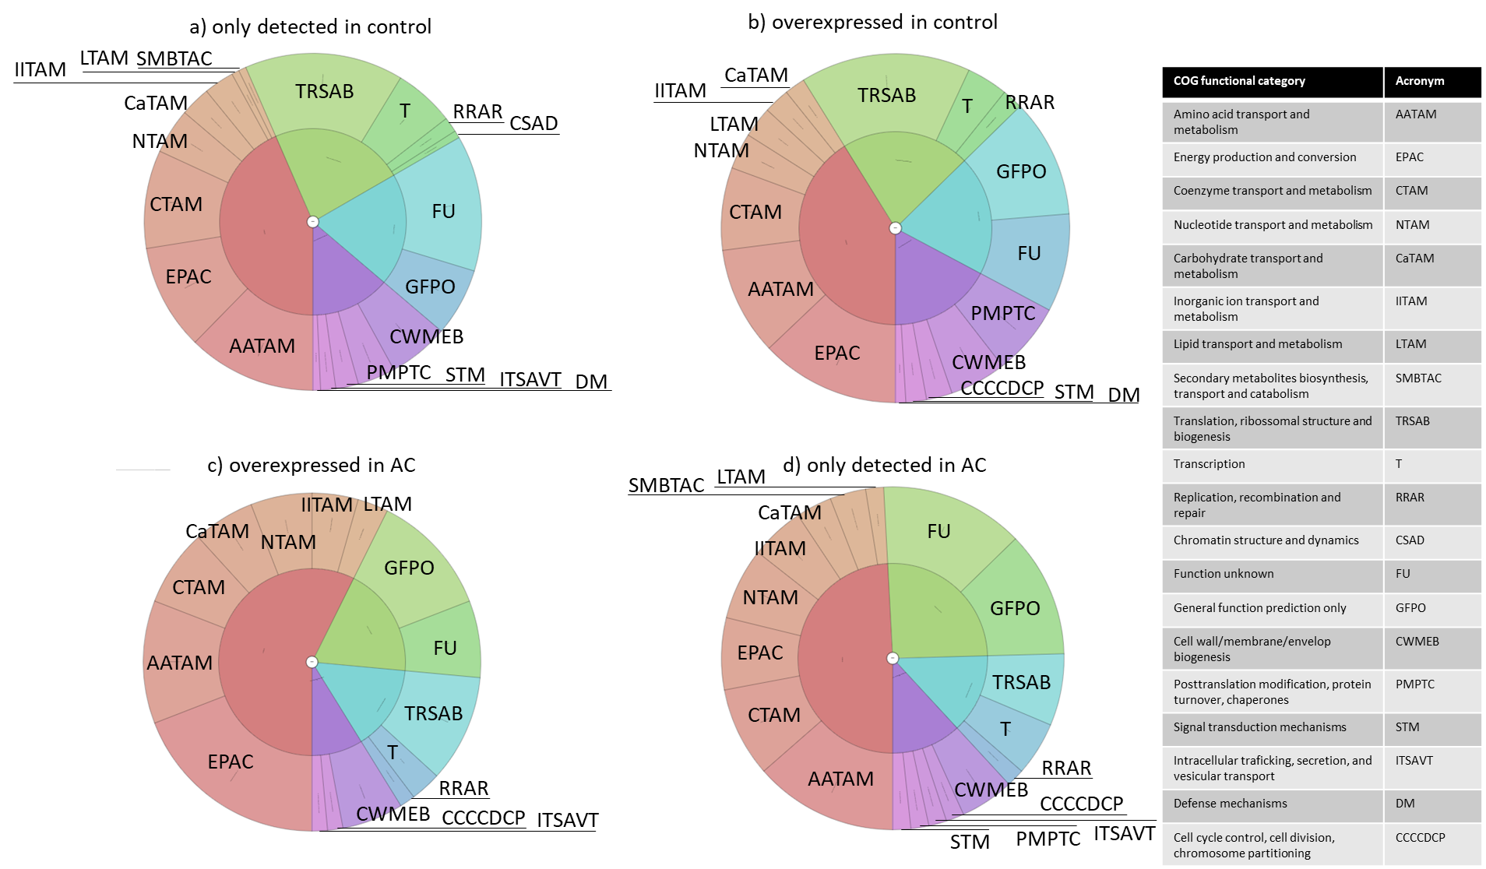

Slide 6
